Slide 1
Introduction to NoSQL Database
Mr. Shrikrishna Anand Narvekar
Assitant Professor
Computer Engineering department
Agnel Institute of Technology and Design

Slide 2
What is NoSQL?
These databases are often used when data is too large, too varied, or generated too quickly for conventional SQL databases to handle efficiently.
Key Qualities of NoSQL Databases:
Schema flexibility
Horizontal Scalability
No Joins
High Availability and Fault Tolerance
Handling Big Data
Notes:
Schema Flexibility: Unlike RDBMS, which require a predefined schema (table structure), NoSQL databases are schema-less. This allows for more flexibility in data storage, especially when dealing with unstructured or semi-structured data. You can store different types of data without needing to modify the schema every time.
Horizontal Scalability: NoSQL databases are designed to scale horizontally across multiple servers. This is in contrast to RDBMS, which usually scale vertically (by adding more resources to a single machine). Horizontal scaling means you can distribute data across many machines, which helps manage large datasets efficiently.
No Joins: Traditional SQL databases often rely on join operations to fetch data from multiple related tables. NoSQL databases tend to avoid joins for better performance, especially when working with distributed data. Instead, they might store related data in a denormalized form (i.e., all in one place).
High Availability and Fault Tolerance: Many NoSQL systems are designed with fault tolerance in mind. They automatically replicate data across multiple nodes so that even if some nodes fail, the system remains available.
Handling Big Data: NoSQL is specifically designed to handle Big Data scenarios—large, complex datasets that grow rapidly, where RDBMS struggle with scale.
Examples of NoSQL Databases:
MongoDB (Document Store)
MongoDB stores data in flexible, JSON-like documents, making it ideal for semi-structured data. Documents can have varying fields, meaning you can store data with different structures in the same collection.
Example Use Case: A product catalog for an e-commerce store. Each product can have different attributes like name, description, price, size, etc. MongoDB can handle the fact that some products may have extra fields like "color" or "brand" without modifying the database schema.
Cassandra (Wide-Column Store)
Cassandra is a distributed NoSQL database designed for scalability and high availability, without compromising on performance. It uses a wide-column model, where data is stored in rows, each of which can have a variable number of columns.
Example Use Case: Logging massive amounts of user activity in real-time across a distributed application. Cassandra’s architecture allows you to scale horizontally by adding more nodes to handle growing data volumes.
Redis (Key-Value Store)
Redis is a key-value store where data is stored as key-value pairs. It's in-memory, which makes it incredibly fast, suitable for caching and session management.
Example Use Case: Caching frequently accessed data in a web application to reduce the load on the main database. For example, storing user session data or caching the results of API calls.
Neo4j (Graph Database)
Neo4j is a graph database that excels in representing and querying complex relationships between entities. Data is stored as nodes and edges, which is ideal for use cases involving relationships.
Example Use Case: Social networks, where users are connected by various types of relationships (friends, followers). Neo4j can easily model and traverse these relationships for efficient querying.
HBase (Wide-Column Store on Hadoop)
HBase is a column-oriented database that runs on top of the Hadoop Distributed File System (HDFS). It's used for real-time read/write access to Big Data.
Example Use Case: Storing the entire set of historical stock prices for real-time queries and analysis, where you need fast access to large amounts of time-series data.

Slide 3
When NoSQL Outperforms RDBMS
Unstructured and semi-structured data: When you're dealing with data that doesn't fit neatly into tables
Scalability: NoSQL databases can scale horizontally to accommodate the growth
Distributed system: When data is spread across multiple location, NoSQL databases are built to handle the complexities of replication and partitioning
High-speed ingestion: NoSQL databases like Cassandra or MongoDB are designed for high write throughput

Slide 4
When to use NoSQL
Below are the key scenarios when we can use NoSQL
Massive parallelization
High Read and Write Throughput with Low Latency
Cost-Effectiveness
Data Models that fit NoSQL Paradigm
No Need for ACID Transactions
Notes:
1. Massive Parallelization
Scenario: You need a system that can handle massive amounts of read and write operations in parallel.
Why NoSQL: NoSQL databases like Cassandra or MongoDB are designed to handle horizontal scaling, meaning they can distribute data across multiple servers (nodes). This allows for massive parallel processing, where many operations can be handled simultaneously, increasing throughput.
Example: An online gaming platform that handles millions of player interactions concurrently.
2. High Read and Write Throughput with Low Latency
Scenario: The system requires fast data ingestion and retrieval with minimal delay.
Why NoSQL: Databases like Redis (key-value store) or Cassandra (wide-column store) offer extremely low-latency reads and writes. These databases are optimized for scenarios where the application needs to handle frequent, high-speed data interactions.
Example: Real-time bidding in ad networks where decisions need to be made in milliseconds.
3. Cost-Effectiveness (Cheap Hardware over Big Iron)
Scenario: You want to scale using affordable, commodity hardware rather than investing in expensive, high-performance systems (big iron).
Why NoSQL: NoSQL databases scale horizontally, meaning you can add more inexpensive servers to the system as data grows, rather than upgrading to more powerful hardware. This leads to cost savings and flexibility in scaling infrastructure.
Example: Social media platforms or streaming services that grow rapidly and require storage across numerous servers without the overhead of expensive data centers.
4. Data Models that Fit NoSQL Paradigms
Scenario: Your data fits one of the NoSQL data models (key-value, document, wide-column, or graph).
Key-Value Stores: Use for simple data retrieval by key (e.g., Redis).
Document Stores: Use when your data is semi-structured or varied (e.g., MongoDB).
Wide-Column Stores: Use when handling time-series or logging data (e.g., Cassandra).
Graph Databases: Use for complex relationships between data entities (e.g., Neo4j).
Why NoSQL: Each NoSQL model is designed to handle specific types of data efficiently. If your data can be easily represented by one of these models, a NoSQL database will likely provide better performance than a relational database.
Example: A recommendation engine for e-commerce that needs to handle user preferences, product catalogs, and browsing histories.
5. No Need for ACID Transactions
Scenario: Your application doesn't require strong ACID (Atomicity, Consistency, Isolation, Durability) compliance and can tolerate eventual consistency.
Why NoSQL: Most NoSQL databases are eventually consistent, meaning they prioritize availability and partition tolerance over immediate consistency. If strong transactional guarantees are not critical, NoSQL databases provide better performance and scalability.
Example: A social media feed where updates can propagate across servers without needing instant consistency.
6. No Need for Complex Transactions
Scenario: Your application doesn't require complex multi-step transactions that are common in financial systems or banking applications.
Why NoSQL: NoSQL databases are built to handle simple, fast operations without the overhead of maintaining complex transactional integrity across multiple entities.
Example: Logging systems, chat applications, or IoT sensor data collection, where each piece of data can be written independently without needing cross-data consistency.
7. Flexible Schema Requirements
Scenario: Your data structure is not fixed, and it may evolve over time with new fields, different data types, and variations in data format.
Why NoSQL: Schema-less databases like MongoDB (document store) allow you to store data in a flexible format, without needing to define the structure upfront. This is beneficial when your data model changes frequently.
Example: A product catalog for an e-commerce platform where products may have different sets of attributes (e.g., size, color, brand).

Slide 5
CAP Theorem
The CAP theorem explains the trade-offs in distributed databases by focusing on three key aspects: Consistency, Availability, and Partition Tolerance.
Consistency: every node always sees the same data at any given instance (i.e., strict consistency)
Availability: the system continues to operate, even if nodes in a cluster crash, or some hardware or software parts are down due to upgrades
Partition Tolerance: the system continues to operate in the presence of network partitions
Notes:
1. Consistency (C)
Simple Explanation: Every time you read data from the system, you get the same, up-to-date information, no matter which server (or node) you ask.
Example: Imagine a bank where if you deposit money, every branch of the bank instantly knows your new balance. Every server has the same information at all times.
Challenge: Ensuring that every node has the latest data can slow things down, especially in large, distributed systems.
2. Availability (A)
Simple Explanation: The system is always up and running. Even if some parts of it fail, the system continues to work, and you can still get responses.
Example: If one server goes down or is being updated, another one takes over, and the system keeps running without you noticing any downtime.
Challenge: Ensuring high availability often means sacrificing strict consistency, because it's difficult to ensure all servers have the latest data when some are down or disconnected.
3. Partition Tolerance (P)
Simple Explanation: The system keeps working even if communication between parts of it (servers) is broken or slow. It can handle network issues without shutting down.
Example: If one data center can't communicate with another due to a network issue, the system still works, though the data might not be perfectly synced.
Challenge: Partition tolerance is critical for large distributed systems, but achieving it can make it harder to guarantee both availability and consistency.

Slide 6
CAP Theorem
The CAP theorem says a distributed system can only provide two out of these three guarantees at any time.
CA (Consistency + Availability): System ensures all nodes have the same data and the system is always up, but it won't work well if parts of the network go down.
  Example: Traditional databases like SQL in a non-distributed system.

Slide 7
CAP Theorem
CP (Consistency + Partition Tolerance): System ensures data consistency and can handle network issues, but you might lose some availability (it may go offline during network partitions).
  Example: Systems like HBase or MongoDB.
AP (Availability + Partition Tolerance): System remains available and handles network issues, but the data might not be consistent across all nodes at all times (eventual consistency).
  Example: Systems like Cassandra or DynamoDB.

Slide 8
Large scale databases
When companies such as Google and Amazon were designing large-scale databases, 24/7 Availability was a key
  A few minutes of downtime means lost revenue
When horizontally scaling databases to 1000s of machines, the likelihood of a node or a network failure
increases tremendously
Therefore, in order to have strong guarantees on Availability and Partition Tolerance, they had to sacrifice “strict” Consistency (implied by the CAP theorem)

Slide 9

Trade-off consistency
Maintaining consistency should balance between the strictness of consistency versus availability/scalability
  Good-enough consistency depends on your application
Loose Consistency
Strict Consistency
Easier to implement, and is efficient
  Generally hard to implement, and is inefficient

Slide 10
Types and examples of NoSQL Database and performance
There are 4 main types of NoSQL Database
Key-Value Store: Designed for storing data in schema-less way. Data is stored as key-value pairs where each key is unique, and its corresponding value can be any type of data(eg: strings, numbers and even more complex objects).
Wide column database: A wide-column database is a type of NoSQL database in which the names and format of the columns can vary across rows, even within the same table. Wide-column databases are also known as column family databases.

Slide 11
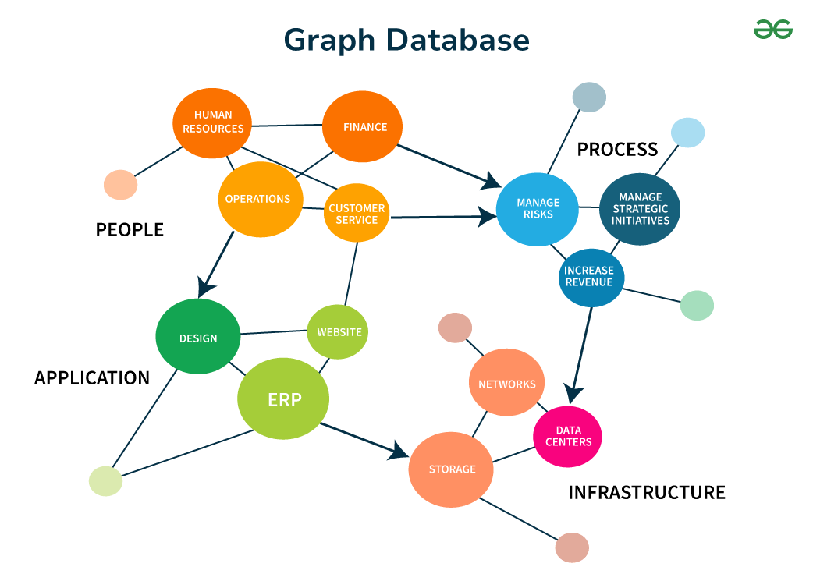
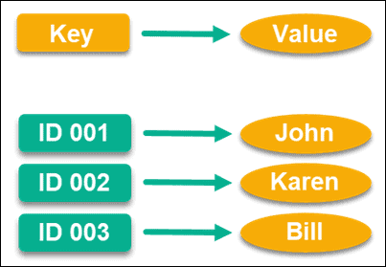

Slide 12
How does wide column store database differ from relational database
A relational database management system (RDBMS) stores data in a table with rows that all span a number of columns. If one row needs an additional column, that column must be added to the entire table, with null or default values provided for all the other rows
Wide-column NoSQL databases still have the concept of rows, but reading or writing a row of data consists of reading or writing the individual columns. A column is only written if there’s a data element for it. Each data element can be referenced by the row key, but querying for a value is optimized like querying an index in a RDBMS, rather than a slow table scan.

Slide 13
Customer_ID | Name | Email | Last_Order_Date | Loyalty_Points
101 | Raj | raj@gmail.com | 2025-10-30 | 120
102 | Priya | priya@gmail.com | 2025-10-25 | 90
103 | Sameer | sameer@gmail.com | NULL | NULL
If you later decide to store an additional column — say, Membership_Tier —
then this column must be added to the entire table, even if some rows don’t have that data.
Customer_ID | Name | Email | Last_Order_Date | Loyalty_Points | Membership_Tier
101 | Raj | raj@gmail.com | 2025-10-30 | 120 | Gold
102 | Priya | priya@gmail.com | 2025-10-25 | 90 | Silver
103 | Sameer | sameer@gmail.com | NULL | NULL | NULL

Slide 14
In a Wide-Column NoSQL Database (like Cassandra or HBase)
Here, data is stored more flexibly — as rows with variable columns, grouped into column families.
Row Key: 101
------------------------------------
Name: Raj
Email: raj@gmail.com
Last_Order_Date: 2025-10-30
Loyalty_Points: 120
Membership_Tier: Gold
Row Key: 102
------------------------------------
Name: Priya
Email: priya@gmail.com
Last_Order_Date: 2025-10-25
Loyalty_Points: 90
Row Key: 103
------------------------------------
Name: Sameer
Email: sameer@gmail.com

Slide 15
Types and examples of NoSQL Database and performance
3. Document database: These databases store data as documents (typically in formats like JSON or BSON). Each document can have a flexible schema, allowing for varying structures of data within the same collection.
It is best for semi-structured data when flexibility is needed for the data model
4. Graph Database: These databases are designed to store and manage data that is highly interconnected. Data is stored as nodes and edges, which represent entities and their relationships. It works on relationship-based storage, making it ideal for recommendation systems and fraud detection systems for social networks.

Slide 16
Key-Value Stores
A key-value store is a schema-less NoSQL model in which data objects are associated with distinct character strings called keys, similar to the data structure known as a hash table.
Unique keys are employed to both identify entities and to locate attribute information
about those entities.

Slide 17
Key-Value Stores
The key-value store does not impose any constraints about data typing or data structure.
However, it's up to the application using the data to understand what the data means and how it’s organized. The system just stores the data, but the application has to know how to read and interpret it correctly.
The core operations performed on a key-value store include :
  Get(key) : It returns the value associated with the provided key.
  Put(key, value) : It associates the value with the key.
  Multi-get(key1, key2, .. , keyN) : It returns the list of values associated with the list of keys.
  Delete(key) : It removes the entry for the key from the data store.

Slide 18
Drawbacks of Key value pair
This model does not provide any kind of traditional database capabilities.
  Those capabilities must be provided by the application itself.
As the volume of data increases, maintaining unique values as keys may become more difficult.
One of the most significant shortcomings of the Key-Value model is a poor applicability to cases that require processing of key ranges.

Slide 19
Document stores
A document store is similar to a key-value store in that stored objects are character-string keys.
  The difference is that the values being stored, which are referred to as "documents," provide some structure and encoding of the managed data.
  There are different standard encodings, including XML (Extensible Markup Language), JSON (Java Script Object Notation), BSON (which is a binary encoding of JSON objects).

Slide 20
Document-based
Example: (MongoDB) document
  {Name:"Jaroslav",
    Address:"Malostranske nám. 25, 118 00 Praha 1”,
    Grandchildren: {Claire: "7", Barbara: "6", "Magda: "3", "Kirsten: "1", "Otis: "3", Richard: "1“}
    Phones: [ “123-456-7890”, “234-567-8963” ]
    }

Slide 21
Difference between Key-value store ad document store
The key difference between a key-value store and a document store is how they manage and query data:
In a key-value store, data is stored as a simple pair: a key (unique identifier) and a value (data), without any additional information or structure. You can only retrieve data by the key, and there’s no built-in way to query based on the value or its contents.
  Example: A dictionary where you look up items only by their key, not by the data inside.
In a document store, data is stored in more complex formats like JSON where each document can have fields (attributes) and structures. These fields act as metadata, allowing you to query data based on the document's content (not just the key).
  Example: You can search for all documents where a "name" field is "John" or where a "price" is greater than 100.

Slide 22
Column-based
Based on Google’s BigTable paper
Like column oriented relational databases (store data in column order) but with a twist
Tables similarly to RDBMS, but handle semi-structured
Data model:
  Collection of Column Families
  Column family = (key, value) where value = set of related columns (standard, super)
  indexed by row key, column key and timestamp

Slide 23
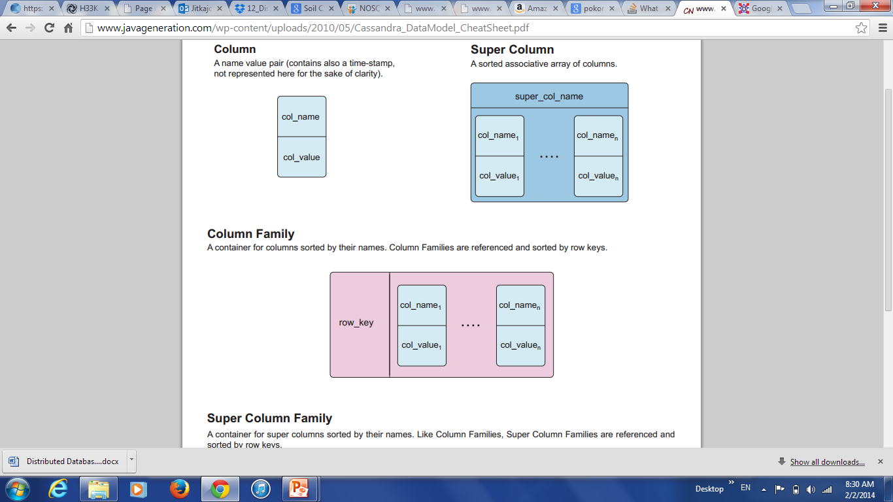
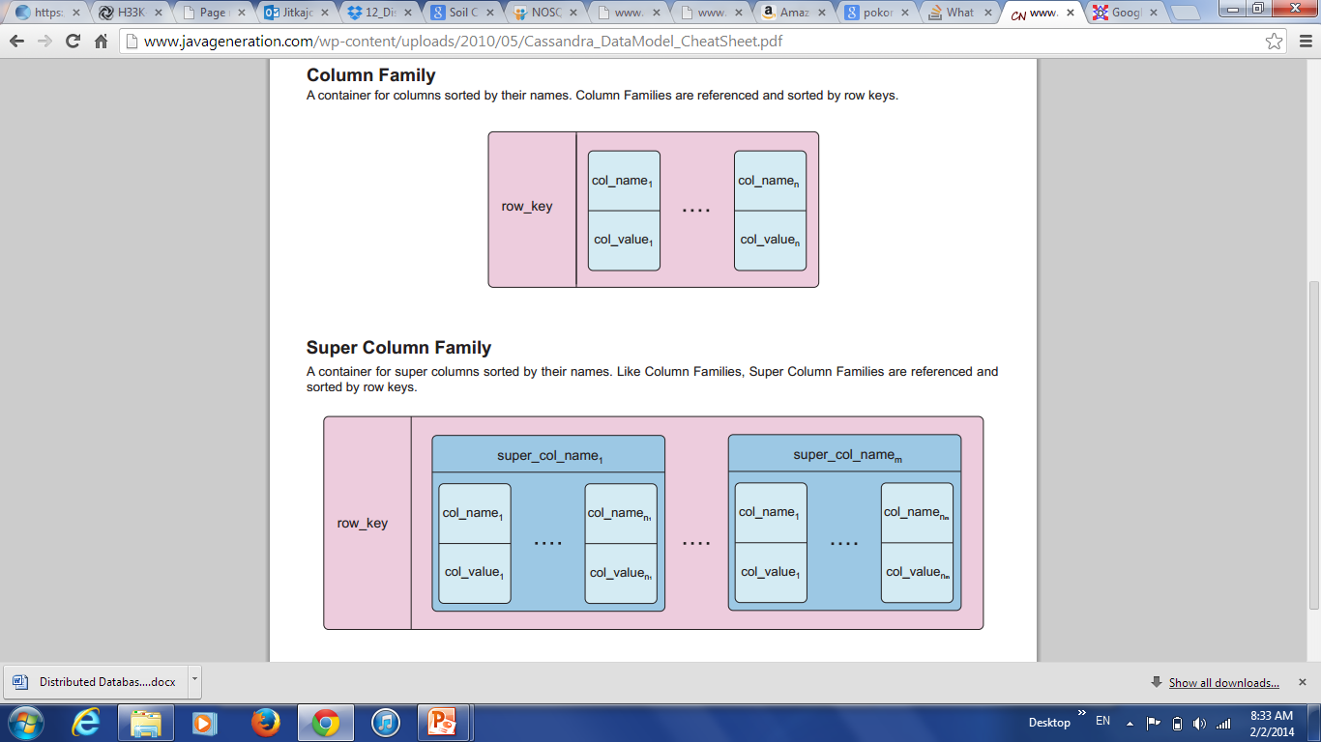
Column-based

Slide 24
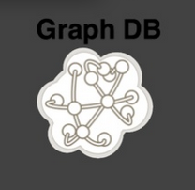
Graph-based
Focus on modeling the structure of data (interconnectivity)
Scales to the complexity of data
Inspired by mathematical Graph Theory (G=(E,V))
Data model:
  (Property Graph) nodes and edges
    Nodes may have properties (including ID)
    Edges may have labels or roles
  Key-value pairs on both
Interfaces and query languages vary
Single-step vs path expressions vs full recursion
Example:
  Neo4j, FlockDB, Pregel, InfoGrid …

Slide 25
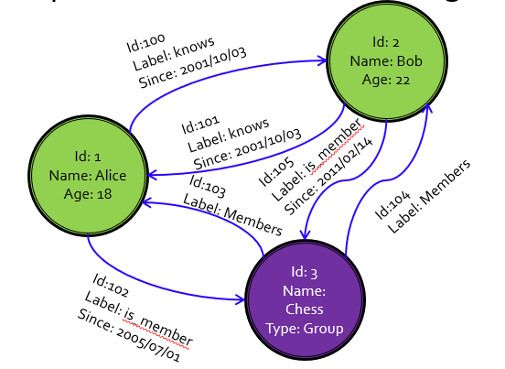
Graph Databases
Data are represented as vertices and edges
Graph databases are powerful for graph-like queries (e.g., find the shortest path between two elements)
E.g., Neo4j and VertexDB

Slide 26
NoSQL Data Models In Detail
Different Types of NoSQL Data Models are :
  Key-value stores
  Document stores
  Column stores
  Graph Base

Slide 27
Advantages of NoSQL Databases
Scalability
Flexibility in schema
High availability and fault tolerance
Better performance for certain use cases
Handling large volumes of data
Distributed architecture
Cost effectiveness
Notes:
1. Scalability
Horizontal Scaling: NoSQL databases are designed to scale horizontally across many servers, meaning they can handle massive amounts of data by adding more servers rather than upgrading a single powerful machine.
Benefit: This makes it easier and more cost-effective to handle growing datasets without major downtime or restructuring.
2. Flexibility in Schema
Dynamic Schema: NoSQL databases allow for a flexible, schema-less structure, meaning you don’t need to define the structure of your data upfront.
Benefit: You can easily modify the data structure on the fly, making it ideal for unstructured or semi-structured data like JSON or XML, where the format of data may evolve over time.
3. High Availability and Fault Tolerance
Built for Distributed Systems: NoSQL databases typically provide strong support for distributed systems, making them more resilient to failures.
Benefit: Data is often replicated across multiple nodes, ensuring that if one node fails, the system remains available.
4. Better Performance for Certain Use Cases
Optimized for Specific Workloads: NoSQL databases are often optimized for specific types of operations like fast reads and writes, especially with large datasets.
Benefit: This results in lower latency and faster performance, particularly for applications that require high-throughput operations, such as real-time data analytics, caching, and content delivery.
5.Handling Large Volumes of Data
Big Data-Friendly: NoSQL databases are well-suited for handling large volumes of unstructured or semi-structured data, such as social media posts, sensor data, logs, or multimedia content.
Benefit: This makes them ideal for modern big data applications like IoT, social networking, and recommendation systems.
6.Distributed Architecture
Data Distribution Across Servers: NoSQL databases are designed to distribute data across multiple servers or data centers.
Benefit: This ensures data redundancy, improved reliability, and the ability to handle geographically distributed users with lower latency.

Slide 28
Advantages of NoSQL Databases
Support for cloud and modern application
Fast development cycle
Handling diverse data types

Slide 29
SQL Vs NoSQL
No | SQL | NoSQL
1 | SQL are primarily called as relational databases | NoSQL database are primarily called as non-relational or distributed database
2 | SQL databases are table based databases | NoSQL databases are document based, key-value pairs, graph databases or wide-column stores.
3 | SQL databases have predefined schema | NoSQL databases have dynamic schema for unstructured data.
4 | SQL databases are vertically scalable | NoSQL databases are horizontally scalable.
5 | SQL databases uses SQL (structured query language) for defining and manipulating the data | NoSQL database, queries are focused on collection of documents. Sometimes it is also called as UnQL (Unstructured Query Language).

Slide 30
SQL Vs NoSQL
NO | SQL | NoSQL
6 | SQL database examples : MySql, Oracle, Sqlite, Postgres and MS-SQL. | NoSQL database examples : MongoDB, BigTable, Redis, RavenDb, Cassandra, Hbase, Neo4j and CouchDb
7 | SQL databases are good fit for the complex query intensive environment | NoSQL databases are not good fit for complex queries.
8 | SQL databases are not best fit for hierarchical data storage. | NoSQL database fits better for the hierarchical data storage as it follows the key-value pair way of storing data similar to JSON data
9 | SQL databases are best fit for heavy duty transactional type applications, as it is more stable and promises the atomicity as well as integrity of the data. | NoSQL for transactions purpose, it is still not comparable and stable enough in high load and for complex transactional applications.
10 | Uses ACID Properties | Uses CAP theorem

